Slide 1
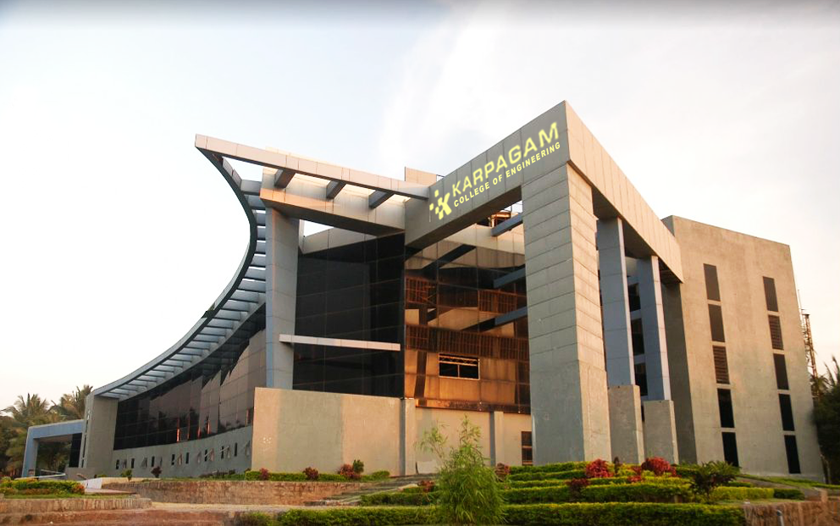

EVIDENCE MANAGEMENT USING BLOCKCHAIN
Team members
717822F218 HARIHARAN.M
717822F232 MUKESH.R
717822F254 SIVASAKTHI.P
,
Assistant Professor,
Department of Information Technology,
Karpagam College of Engineering, Coimbatore

Slide 2
Abstract
Snaptok revolutionizes communication education with its groundbreaking platform, integrating AI, computer vision, and natural language processing. Through live video sessions, facial expression analysis, and speech-to-text transcription, students receive real-time feedback on verbal and non-verbal cues.
Key features include hesitation detection, pitch modulation analysis, and personalized question prompts, catering to diverse proficiency levels. With a focus on individual growth and societal impact, Snaptok promises enhanced confidence, employability, and social interaction.
Positioned to redefine communication training, it heralds a transformative learning experience poised for widespread adoption.
Snaptok: Revolutionizing Communication Education
Platform: AI-driven
Features: Real-time feedback
Focus: Individual growth
Impact: Societal benefits
Future: VR integration

Slide 3
Objective
Ensure Integrity: Store tamper-proof records of all evidence transactions using blockchain's immutable nature.
Enhance Transparency: Provide a verifiable chain of custody for real-time tracking from collection to court.
Improve Accountability: Record all actions with timestamps and authorized user identities for a transparent audit trail.
Automate Workflows: Use smart contracts to automate evidence transfers, approvals, and access control.
Implement Access Control: Enforce role-based access to prevent unauthorized handling.
Prevent Misplacement: Log and track all evidence securely to reduce loss or misplacement.
Build Trust: Increase public confidence through transparent and secure evidence handling.

Slide 4
Problem Statement
Problem Statement :
The current evidence management system is prone to tampering, loss, and inefficiencies, compromising the integrity and traceability of evidence.

Slide 5
Key features of SNAPTOK
Customizable Training Models: Offers the flexibility to fine-tune pre-trained models with user-specific data, enhancing the accuracy and relevance of feedback for individual users.
User-Friendly Interface: Provides an intuitive and easy-to-use interface, allowing users to practice their speaking skills with minimal setup and technical knowledge.
Diverse Speech Corpus: Incorporates a wide-ranging dataset that includes various speaking styles and contexts, ensuring robust and versatile performance across different speech scenarios.
Post-Processing Techniques: Utilizes advanced post-processing methods like Gaussian filtering and morphological opening to refine detection results and reduce false positives.
Progress Tracking and Reporting: Includes features for tracking user progress over time, providing detailed reports on improvements and areas that still need work, helping users to continuously enhance their public speaking abilities.

Slide 6
Software Requirements
Goal: Create a dataset that includes hesitation sounds explicitly labeled.
Steps:
1. Gather Data:
i.Collect audio recordings from various sources where hesitation sounds are naturally present. This could include interviews, casual conversations, podcasts, etc.
ii.Ensure diversity in accents, speaking styles, and environments to make the model robust.
2,Annotate the Data:
i. Use tools like ELAN or Praat to manually annotate the audio files.
ii..Label hesitation sounds explicitly. For example, transcriptions should include "uh", "umm", "hmm" as part of the text.

Slide 7
Preprocess the Data
Goal: Prepare the data for training by ensuring hesitation sounds are treated as distinct tokens.
Steps:
1. Tokenization:
i. Use a tokenizer that can handle hesitation sounds as separate tokens.
ii. If using a library like Hugging Face's transformers, customize the tokenizer to include hesitation sounds.
2. Data Augmentation (Optional):
i. If the dataset is small, create synthetic samples by adding hesitation sounds to existing clean speech data.

Slide 8
Fine-Tune the Model
Goal: Train a pre-trained speech-to-text model to recognize and transcribe hesitation sounds.
Steps:
1. Choose a Pre-trained Model:
i. Use a model like Wav2Vec 2.0 by Facebook AI, which is well-suited for speech recognition tasks.
2. Fine-Tuning Process:
i. Load the pre-trained model and tokenizer from Hugging Face's transformers library.
ii. Prepare the dataset, ensuring it is tokenized correctly.
iii. Fine-tune the model with the dataset that includes hesitation sounds.

Slide 9
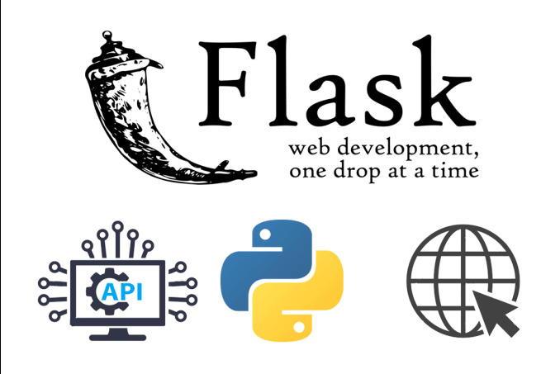
Tech Stack
Frontend: HTML for structure, CSS for styling, JavaScript for interactivity, WebRTC for video capture.
Backend: Flask for the web framework, OpenCV for computer vision, TensorFlow/Keras for machine learning.
Tools & Libraries: Python for programming, Flask-SQLAlchemy for database management (if needed), Jinja2 for templating.
Development: Visual Studio Code/PyCharm for coding, Postman for API testing, PyTest/Unittest for writing and running tests.

Slide 10
Competitive Advantage of SNAPTOK
Advanced AI Technology | Comprehensive Feedback | Customized Learning | Focus on Soft Skills
SNAPTOK utilizes cutting-edge AI algorithms to transcribe speech accurately, identify hesitation words, and provide personalized feedback, delivering a superior learning experience for users. | Unlike basic platforms, SNAPTOK offers detailed insights into users' speech patterns, word usage, and presentation style, empowering them to make targeted improvements in their communication skills. | SNAPTOK tailors its recommendations and feedback to each user's individual needs and learning pace, optimizing the effectiveness of the skill-building process. | While speech recognition tools exist, SNAPTOK stands out by specifically targeting the development of critical soft skills like public speaking and communication, addressing a pressing need in the education and job market.

Slide 11
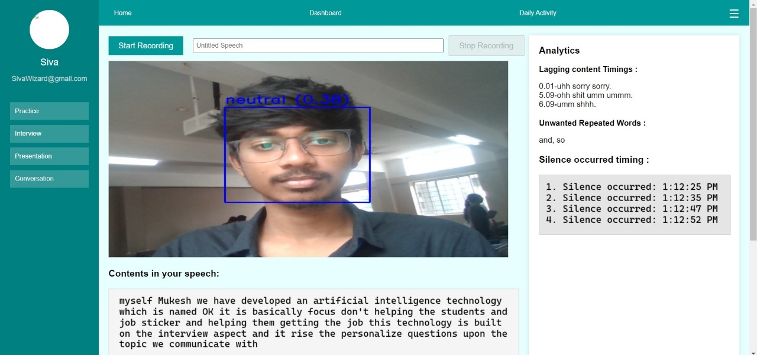
Sample Model

Slide 12
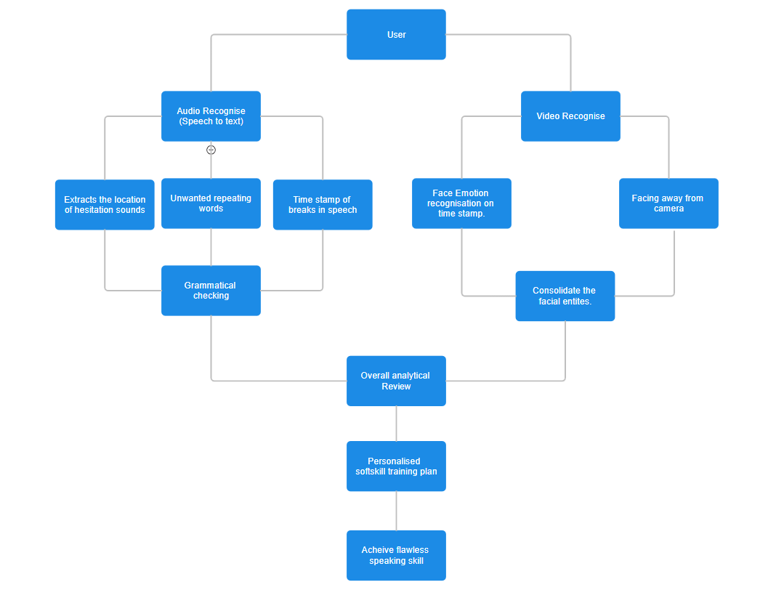
Flow Diagram

Slide 13
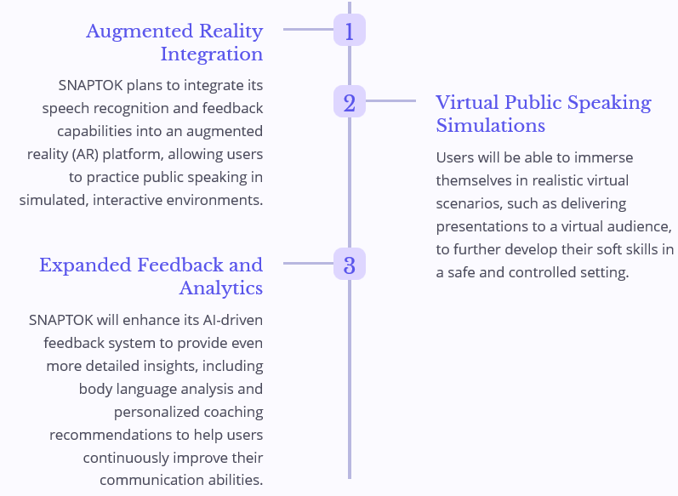
Future Scopes

Slide 14
References
Speech Module:
Research on Speech Separation and Recognition Algorithm Based on Deep Learning :
Author(s): Sarah Wan
Published in: 2021 IEEE International Conference on Power, Intelligent Computing and Systems (ICPICS)
Publisher: IEEE
DOI: 10.1109/ICPICS52425.2021.9524204
Effective speech emotion recognition using deep learning approaches for Algerian dialect :
Author(s): Raoudha Yahia Cherif, Abdelouahab Moussaoui, Nabila Frahta, Mohamed Berrimi.
Published in: 2021 International Conference of Women in Data Science at Taif University (WiDSTaif )
Publisher: IEEE
DOI: 10.1109/WiDSTaif52235.2021.9430224
Face Module:
Real-Time Emotion Recognition from Facial Expressions using Artificial Intelligence:
Author(s): Prashant Dhope, Mahesh B. Neelagar.
Published in: 2022 2nd International Conference on Artificial Intelligence and Signal Processing (AISP)
Publisher: IEEE
DOI: 10.1109/AISP53593.2022.9760654
Facial Expression Recognition Using CNN:
Author(s): Fahreddin M. Sadikoğlu, Mohamed Idle Mohamed.
Published in: 2022 International Conference on Artificial Intelligence in Everything (AIE)
Publisher: IEEE
DOI: 10.1109/AIE57029.2022.00025

Slide 15
Conclusion
Snaptok's use of advanced AI technologies provides an effective and comprehensive solution for enhancing public speaking and interview skills. By offering real-time feedback, personalized coaching, and interactive exercises, the platform empowers users to develop critical soft skills, boosting their confidence and communication effectiveness in both personal and professional contexts

Slide 16
THANK YOU!

